Slide 1

Flipkart E-commerce Review-based Product Categorization

Slide 2
Project Description
The Kaggle Flipkart Products Review Dataset is a collection of reviews of products sold on the Indian ecommerce website Flipkart. The dataset contains product reviews, ratings, and other metadata such as product name and price.
A Decision Support System (DSS) could be designed to analyze this dataset and provide insights to improve the e-commerce platform's operations and customer experience.
We focus on improving the sales of the products by analyzing the product ratings by customers, we categorize the products based on the positive and negative reviews of the product.
The ultimate aim of our project is to make the declined mark of products which falls in the negative reviews of the market, apparently to be pushed to the upward mark of the market.

Slide 3
Business Approach
The hypothesis for this analysis is that by analyzing customer reviews and classifying them into positive, negative, or neutral sentiments, we can gain insights into customer preferences, satisfaction levels, and product performance, which can be used by Flipkart to improve its product offerings and overall customer experience.
In the context of the Flipkart Products Review Dataset, descriptive modeling will be used to identify the most popular product categories or brands and other trends in the data.
Initially, we use descriptive analysis. It provides us what is the problem occurring with the products by analyzing the rating given by the customers.
We calculate the average rating of the products and this will provide us with an idea of which products are generally well-received by customers and which ones are not.

Slide 4
Data Fields Size – This dataset consists of 189,874 rows and 5 columns
S. No. | Column Name | Description | Data Type
1. | Product Name | Products that customers ordered on Flipkart. | object
2. | INR | Price of the product in INR currency. | float64
3. | Rate | Rating of the products given by customers. | float64
4. | Review | Review of the products by customers. | object
5. | Summary | Customers’ feedback about how efficient the products they ordered. | object

Slide 5
Data pre-processing
In this project, we use Anaconda – Jupyter Notebook to model our dataset and implement the system.
Firstly, we read the data and perform some pre-processing
The rows containing null values are dropped and the size of the dataset is changed to 189857 rows and 5 columns
We removed inaccurate data like “??” in the price and summary columns and extra spaces in the summary, product name, and review columns.

Slide 6
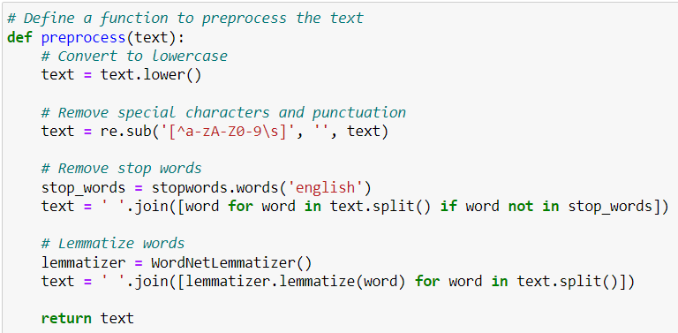
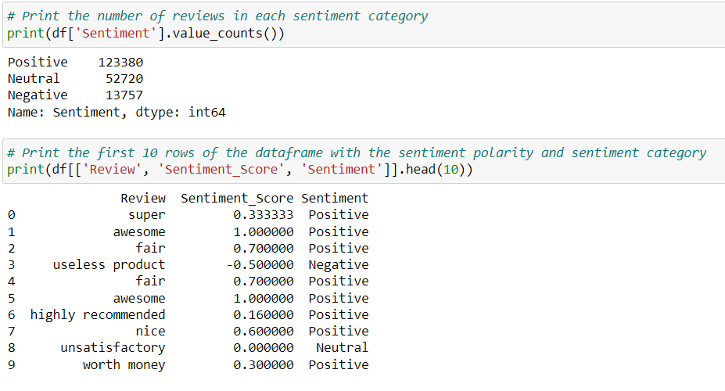
Sentiment Prediction
We perform Sentiment Analysis on customer reviews and categorize the products based on positive, negative, and neutral sentiments.
To perform sentiment analysis, firstly stop words are removed, and lemmatization is performed.
It is found that there were 1,23,380 positive reviews, 13,757 negative reviews and 52,720 neutral reviews.

Slide 7
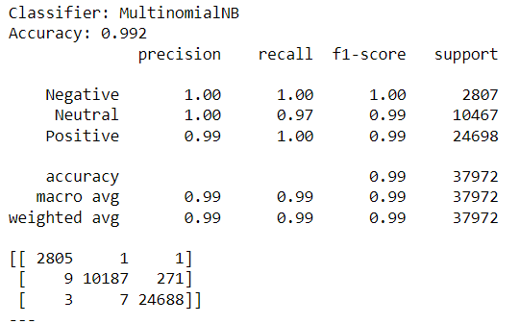
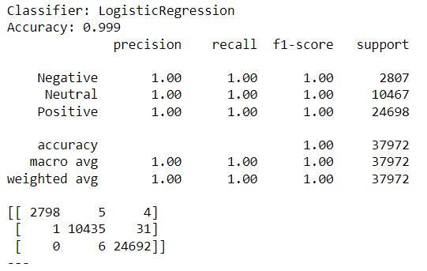
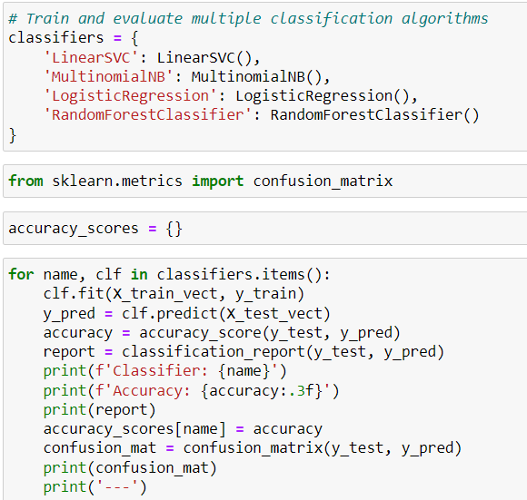
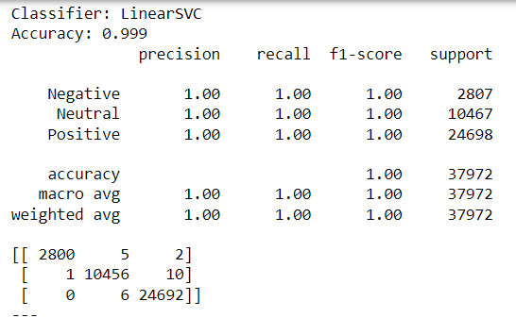
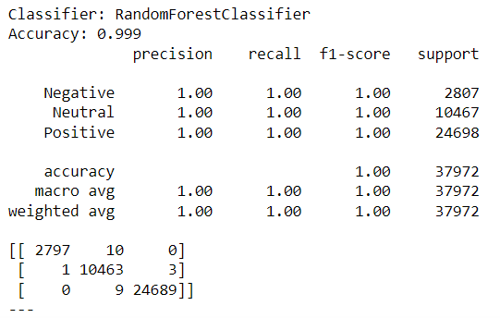
Model Building

Slide 8
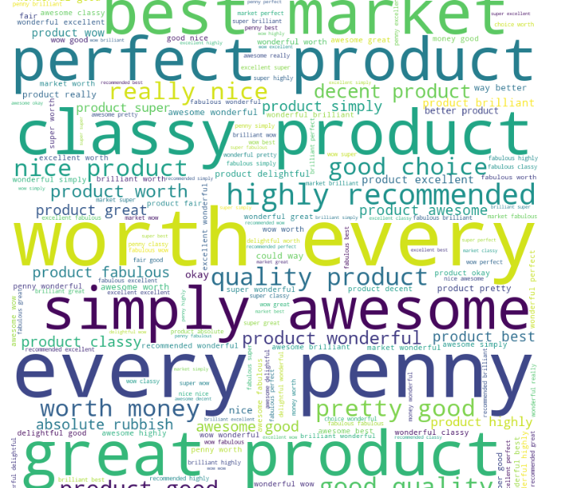
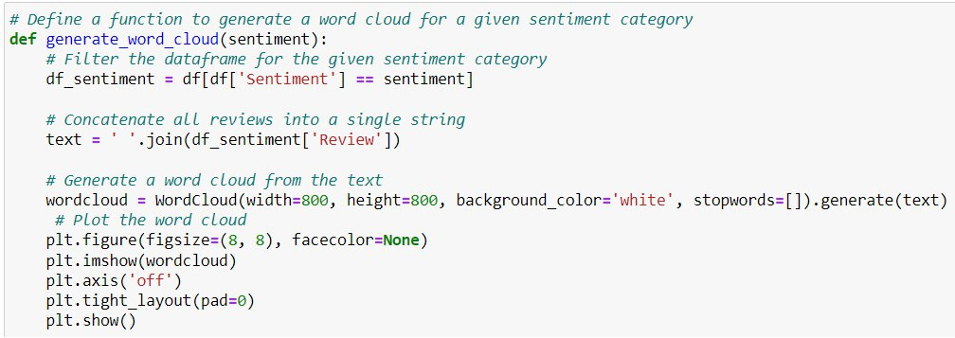
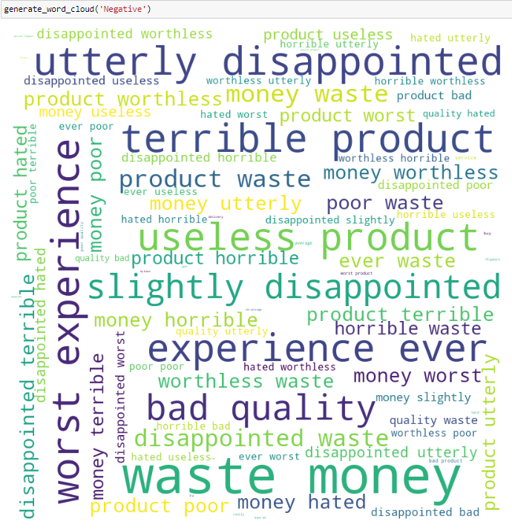
Word Cloud

Slide 9
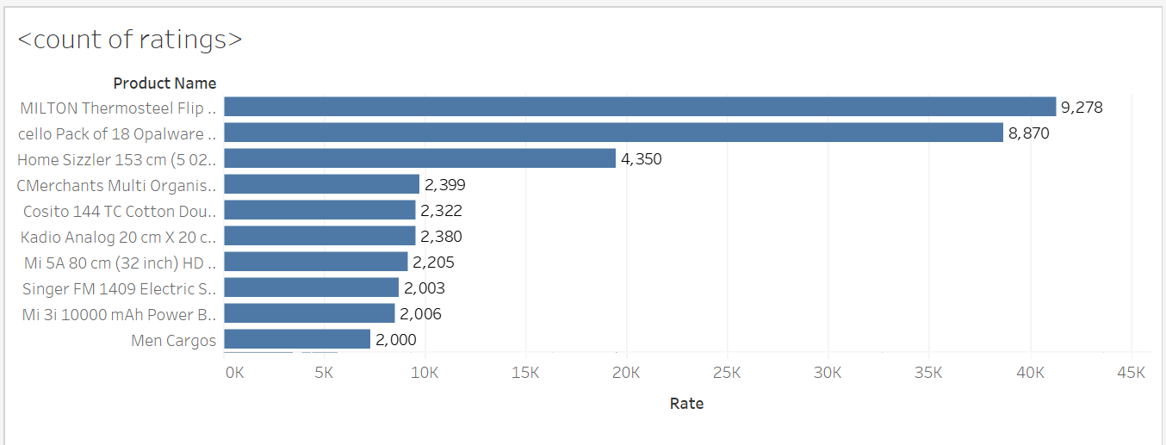
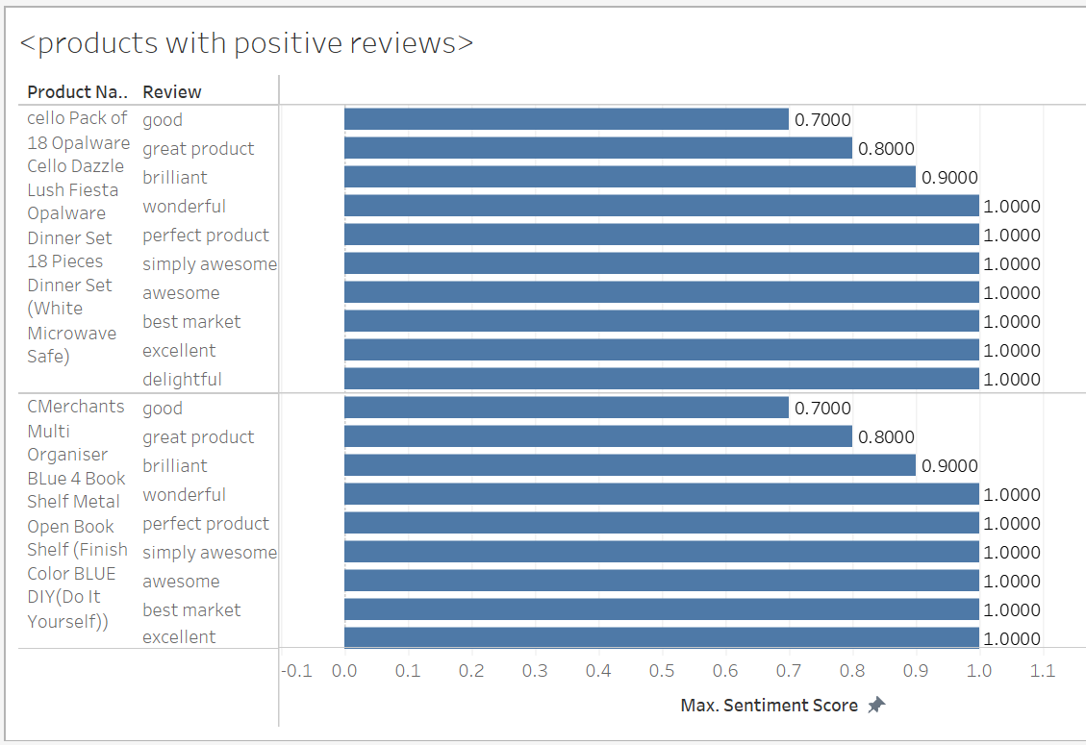
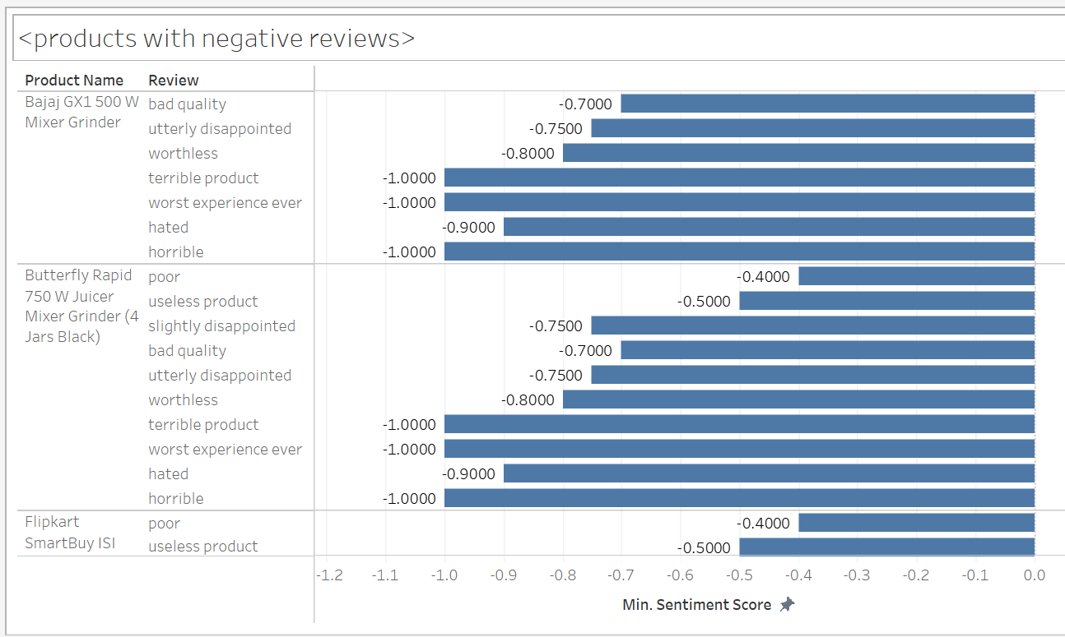
Visualization

Slide 10
Project Constraints
Regression models could not be implemented as some errors were encountered while processing the price column.
The dataset does not contain the location of the customers which disables locating the review categories geographically.
The analysis is restricted to the available data.

Slide 11
Conclusion
By performing the above analysis we have classified the products based on reviews which categorized them into different sentiment categories.
An overall sense of customer satisfaction levels can be visualized by analyzing the number of reviews in each sentiment category. They can identify areas where they are performing well and areas where they need to improve.
By comparing the accuracy scores of different classification algorithms, Flipkart can identify the best algorithm for sentiment analysis and classification of customer reviews.
Word clouds can identify common themes and keywords associated with positive, negative, and neutral reviews. This can help understand what customers like and dislike about their products and make improvements accordingly.

Slide 12
Link to Dataset
Dataset source: www.kaggle.com
Link: https://www.kaggle.com/datasets/mansithummar67/flipkart-product-review-dataset

Slide 13
THANK YOU

